Slide 1
Adaptive immunity & Rheumatic diseases
A.R.Rajaei MD
arrajaei@gmail.com
Rheumatology Department
Loghman hospital

Slide 2
Adaptive Immune Response
Adaptive immunity is an immunity that occurs after exposure to an antigen either from a pathogen or a vaccination.
This part of the immune system is activated when the innate immune response is insufficient to control an infection. In fact, without information from the innate immune system, the adaptive response could not be mobilized.
There are two types of adaptive responses: the cell-mediated immune response, which is carried out by T cells, and the humoral immune response, which is controlled by activated B cells and antibodies.
Adaptive immunity & Rheumatic diseases
A.R.Rajaei MD

Slide 3
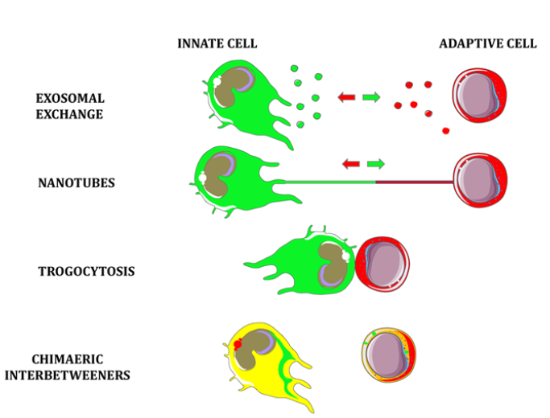
Adaptive immunity & Rheumatic diseases
A.R.Rajaei MD
Notes:
Blurring the difference between adaptive and innate cells is mediated by their intercellular transfer of membranes and cytosolic components either by exosomal exchange, nanotubes, or by trogocytosis

Slide 4
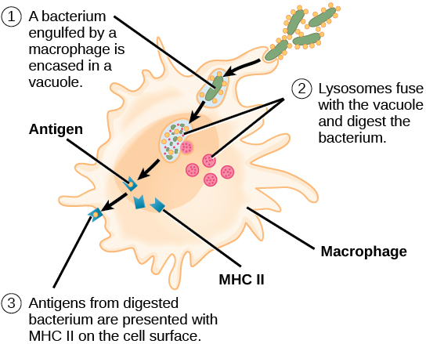
Adaptive immunity & Rheumatic diseases
A.R.Rajaei MD

Slide 5
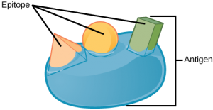
An antigen is a macromolecule that reacts with components of the immune system. A given antigen may contain several motifs that are recognized by immune cells. Each motif is an epitope. In this figure, the entire structure is an antigen, and the orange, salmon and green components projecting from it represent potential epitopes.
Adaptive immunity & Rheumatic diseases
A.R.Rajaei MD

Slide 6
Key Points
■ Cells of the adaptive immune system, T and B lymphocytes, use somatic gene recombination to produce large repertoires of antigen-recognizing T-cell receptors and immunoglobulins.
■ In contrast to the innate immune system, the adaptive repertoire of lymphocytes can recognize and eliminate a broad variety of new antigens not previously encountered by the host or the host’s species. Clonal selection preserves and expands the lymphocytes whose products prove useful in protecting the host.
■ The adaptive immune system has an inherent potential for self-reactivity, or autoimmunity. The potential to induce autoimmunity is usually controlled by a combination of deletional and regulatory mechanisms jointly referred to as immune self-tolerance.
■ Triggering of cell-surface receptors activates intracellular signaling cascades controlling lymphocyte differentiation, maturation, immune responsiveness, tolerance, and death.
■ Helper T cells of diverse phenotypes coordinate the functioning of the adaptive and innate immune systems.
■ All these processes provide targets for therapeutic manipulation in autoimmune rheumatic diseases.
Adaptive immunity & Rheumatic diseases
A.R.Rajaei MD

Slide 7
Both innate and adaptive parts of the immune system must first recognize their targets; this process is commonly referred to as the cognitive phase. It is followed by the effector phase, during which the immune cells respond to the threat.
The cognitive phase defines the central difference between innate and adaptive immunity. In the innate immune system, the PRRs are rather ubiquitously expressed and are ready to bind PAMPs immediately, thus instantly activating the effector phase. In contrast, the adaptive recognition system is constructed to identify and respond effectively to myriads of unpredictable new foreign molecules (antigens) without confusing them with the body’s own molecules. This process is more complex and less efficient than the functioning of innate immunity, and therefore it is slower.
To save time during the subsequent encounters with the newly “learned” antigens, adaptive immunity is capable of retaining specific immunologic memory of previous experiences and responds much faster and more effectively the next time a previously encountered antigen threatens the host.
Adaptive immunity & Rheumatic diseases
A.R.Rajaei MD
Notes:
pattern recognition receptors (PRRs). the pathogen-associated molecular patterns (PAMPs)

Slide 8
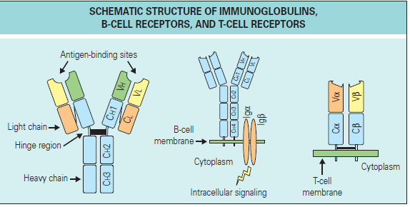
A model of immunoglobulin G (IgG) is shown on the left, a model of surface IgM B-cell receptor is shown in the middle, and a model of T-cell receptor αβ is shown on the right. Constant (C) and variable (V) domains are indicated, as well as heavy (H) and light (L) chains of immunoglobulins.
Adaptive immunity & Rheumatic diseases
A.R.Rajaei MD

Slide 9
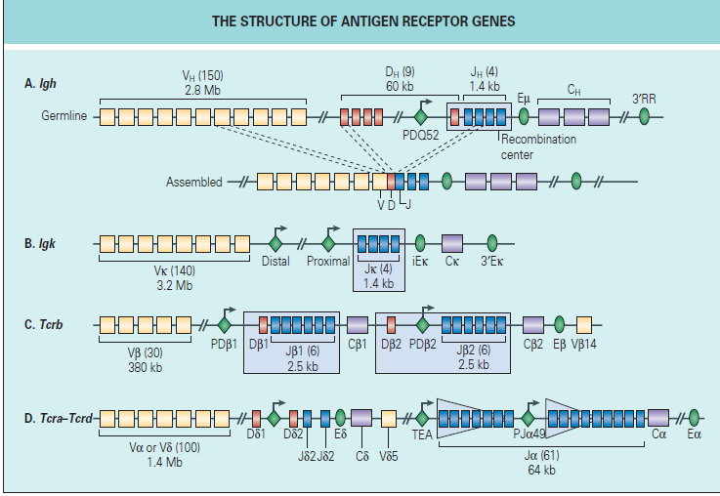
Adaptive immunity & Rheumatic diseases
A.R.Rajaei MD
Notes:
Schematic diagrams of mouse antigen receptor loci. Variable (V), diversity (D), and joining (J) gene segments are
represented as yellow, red, and blue rectangles, respectively; constant (C) regions are shown as gray rectangles; enhancer elements
are shown as green ovals; and germline promoters associated with recombination centers are depicted as green diamonds with
arrows. The approximate sizes of the regions within each locus are indicated, together with the approximate number of gene
segments in each region (shown in parentheses). The recombination centers (blue shaded areas) are the regions that are bound
by recombination activating gene (RAG)1 and RAG2 proteins when the loci are in their germline configurations. (A) The immunoglobulin
heavy chain (Igh) locus in its germline and assembled configurations. (B) The germline Igκ locus (Igk). (C) The germline
T cell receptor β-chain (Tcrb) locus. (D) The germline Tcra–Tcrd locus. The Tcra recombination center is represented by two
triangles to depict the 5′ to 3′ gradient of RAG binding observed downstream of the T early α (TEA) element and of the Jα49
germline promoter. After transcription of the assembled regions into pre–messenger RNA, the final messenger RNA transcript is
formed by RNA splicing. (Reproduced with permission from Macmillan Publishers Ltd: Schatz DG, Ji Y. Recombination centres
and the orchestration of V(D)J recombination.

Slide 10
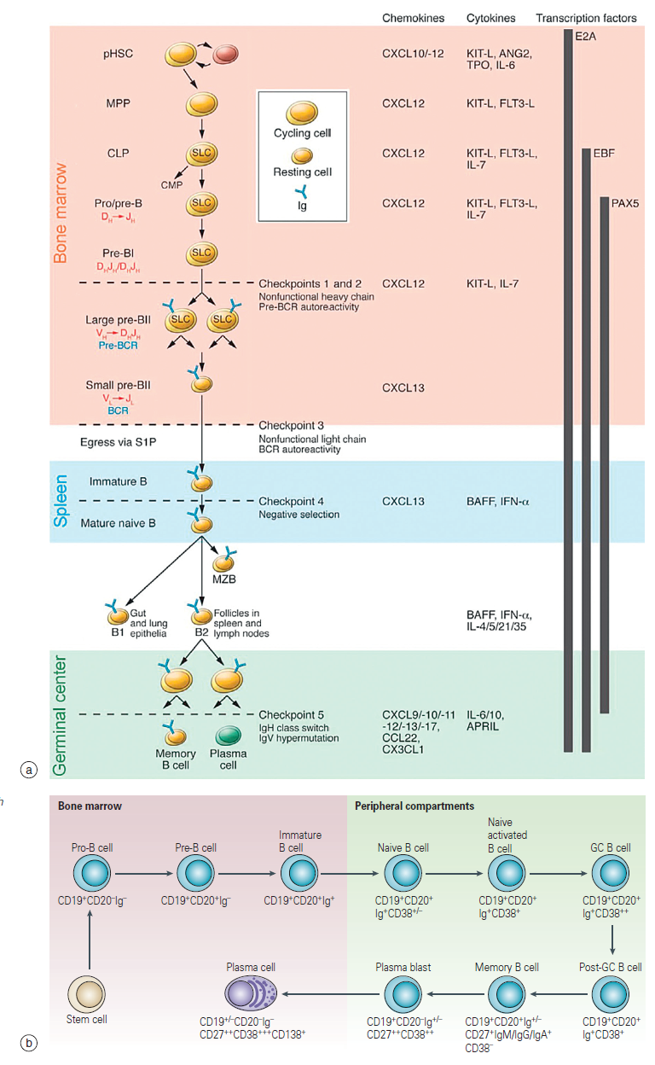
Adaptive immunity & Rheumatic diseases
A.R.Rajaei MD
Notes:
B-cell development. (a) B cells are continuously generated from pluripotent HSCs (pHSCs), multipotent myeloid/lymphoid progenitors (MPPs), common lymphoid progenitors (CLPs), and pro-B and pre-B cells. Key chemokines, cytokines, and transcription factors controlling B-cell differentiation are shown. B-cell receptors (BCRs) are generated by stepwise rearrangements of Ig segments. Pre-B cells that have undergone productive VHDHJH rearrangement express an Igμ chain that can pair with surrogate light chain (SLC) to form a pre-BCR, which stimulates large pre-B cell proliferation. Then, VL-to-JL rearrangement occurs in small pre-BII cells, which become surface BCR–expressing immature B cells. They then enter the spleen, maturing into marginal zone B cells (MZB) and follicular B cells, which are organized in B cell–rich follicles where T cell–dependent antigenic stimulation promotes development of germinal centers (green region). Antigen-specific follicular helper T cells induce B cell Ig class switching and Ig V-region hypermutation and help to develop
memory B cells and plasma cells. The developing B-cell repertoires are monitored for structural fitness and autoreactivity at five checkpoints. CMP, Common myeloid progenitor; S1P, sphingosine-1-phosphate, mediates egress of B cells from bone marrow. (b) Changes in the expression of cell-surface markers during maturation of B cells.

Slide 11
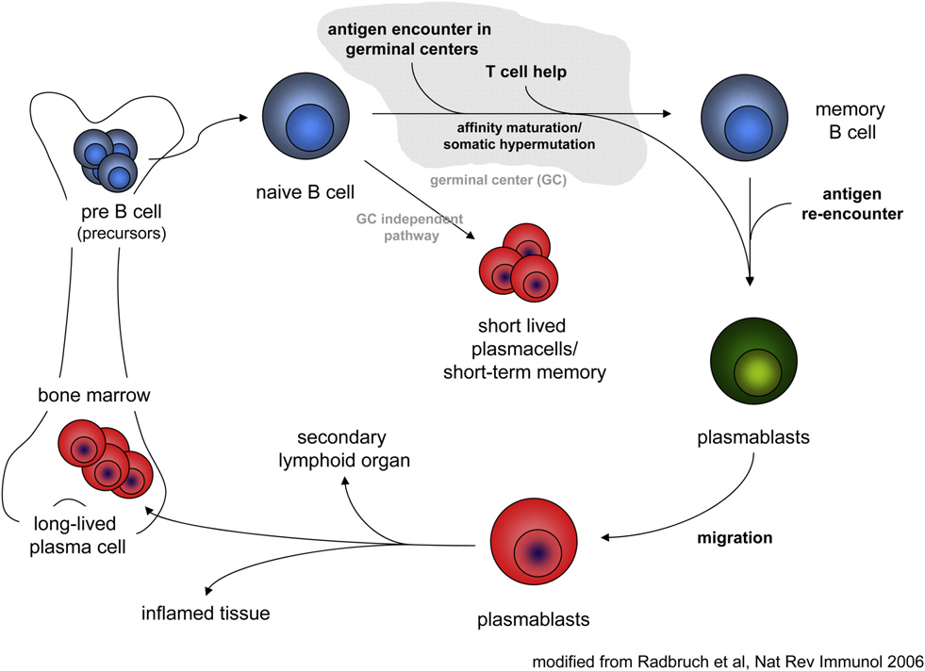
Adaptive immunity & Rheumatic diseases
A.R.Rajaei MD
Notes:
Life cycle of B cells. B cell precursors are generated in the bone marrow, from which they exit and mature into naïve B cells. Contact with antigen in combination with TLR-agonists and cytokines can induce naïve B cells to develop into short-lived, antibodyproducing plasma cells. This process is independent of germinal centers and T cell help. In germinal centers, naïve B cells encounter antigen, receive help from follicular T cells and undergo affinity maturation and class-switch recombination. This process generates plasmablasts that migrate to secondary lymphoid organs, sites of inflammation or the bone marrow, where they compete for survival niches and become long-lived plasma cells. Memory B cells themselves are also long-lived. Upon re-encounter with their cognate antigen, they can differentiate into plasmablasts and plasma cells.

Slide 12
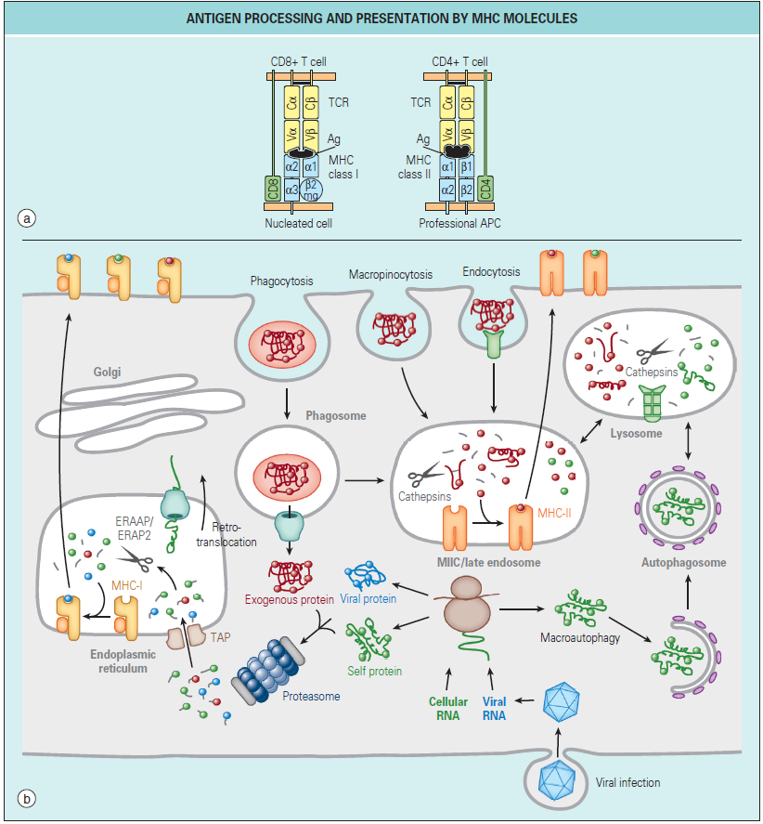
Adaptive immunity & Rheumatic diseases
A.R.Rajaei MD
Notes:
Presentation of antigen peptides by major histocompatibility complex (MHC) molecules (a) and trafficking of antigens for processing
and presentation with MHC (b). Cytosolic proteins are processed primarily by the action of the proteasome. The short peptides are then
transported into the endoplasmic reticulum (ER) by the transporter associated with antigen processing (TAP) for subsequent assembly with
MHC-I molecules. In certain antigen-presenting cells, particularly dendritic cells, exogenous proteins can also be fed into this pathway by
retrotranslocation from phagosomes, a phenomenon known as cross-presentation. The retrotranslocation channels may be recruited from the
ER, where they are used for ER-associated degradation, or ERAD, of misfolded transmembrane or secretory proteins. Exogenous proteins are
primarily presented by MHC-II molecules. Antigens are internalized by several pathways, including phagocytosis, macropinocytosis, and
endocytosis, and eventually traffic to a mature or late endosomal compartment, often called the MHC-II compartment, or MIIC, where they
are processed and loaded onto MHC-II molecules. Cytoplasmic/nuclear antigens can also be trafficked into the endosomal network via autophagy
for subsequent processing and presentation with MHC-II molecules.

Slide 13
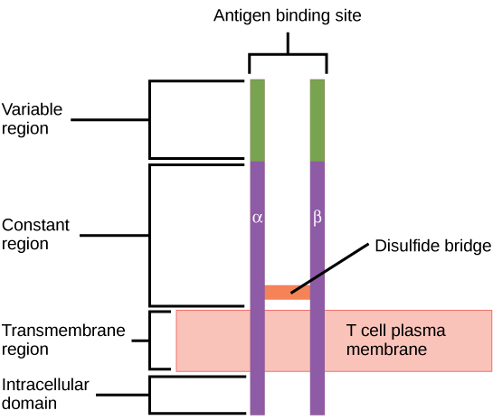
A T cell receptor spans the membrane and projects variable binding regions into the extracellular space to bind processed antigens via MHC molecules on APCs.
Adaptive immunity & Rheumatic diseases
A.R.Rajaei MD

Slide 14
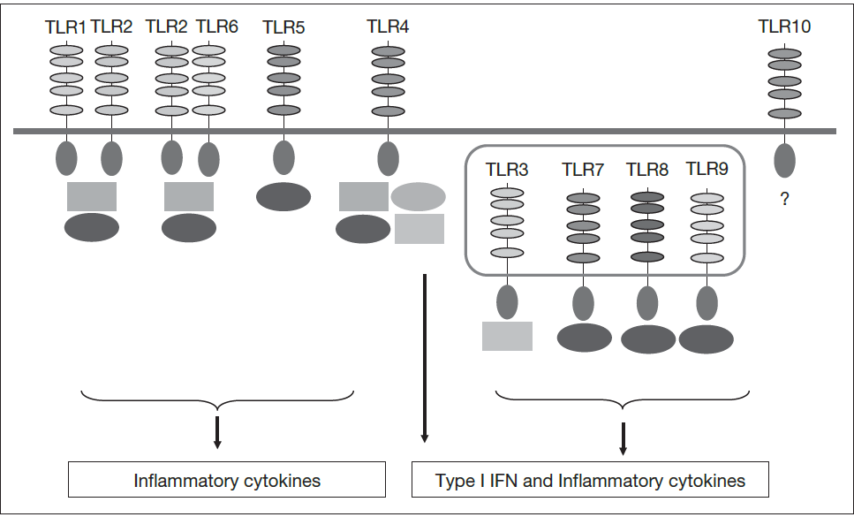
Adaptive immunity & Rheumatic diseases
A.R.Rajaei MD
Notes:
TLRs expressed by human cells are located at the extracellular membrane and on intracellular vesicles. The various adapter molecules utilized to initiate intracellular signaling are shown as differently shaded squares and circles. The outcome of type-I interferon (IFN) production or inflammatory cytokine production is shown in relation to each TLR.

Slide 15
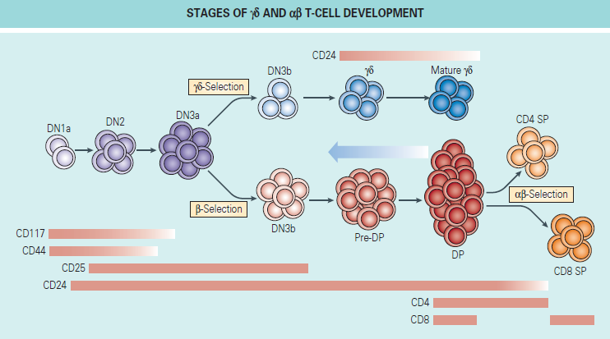
Adaptive immunity & Rheumatic diseases
A.R.Rajaei MD
Notes:
Stages of γδ and αβ T-cell development. The expression pattern of cell surface markers used to distinguish specific developmental subsets is shown below or above each stage. The main T-cell receptor (TCR)–mediated checkpoints are indicated, with the main αβ–γδ lineage divergence step taking place
at the double-negative 3a (DN3a) to DN3b transition. DP, double positive; SP, single positive for CD4 and/or CD8 expression. (Adapted with
permission from Macmillan Publishers Ltd: Ciofani M, Zuniga-Pflucker JC. Determining γδ versus αδ T cell development

Slide 16
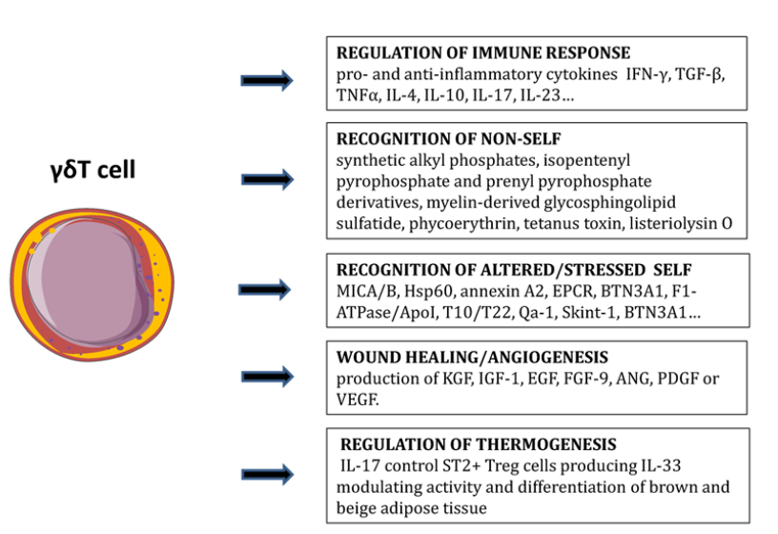
Adaptive immunity & Rheumatic diseases
A.R.Rajaei MD
Notes:
Human γδT cells are a bridge between the innate and the adaptive immune system They use TCR as a PRR to recognize multiple ligands including antigens of stressed cells. In addition to a large scale of pro- and
anti-inflammatory cytokines, γδ T cells represent an important source of growth factors which are essential for wound healing and angiogenesis. Finally, γδT cells may play a role in the systemic metabolic regulation.

Slide 17
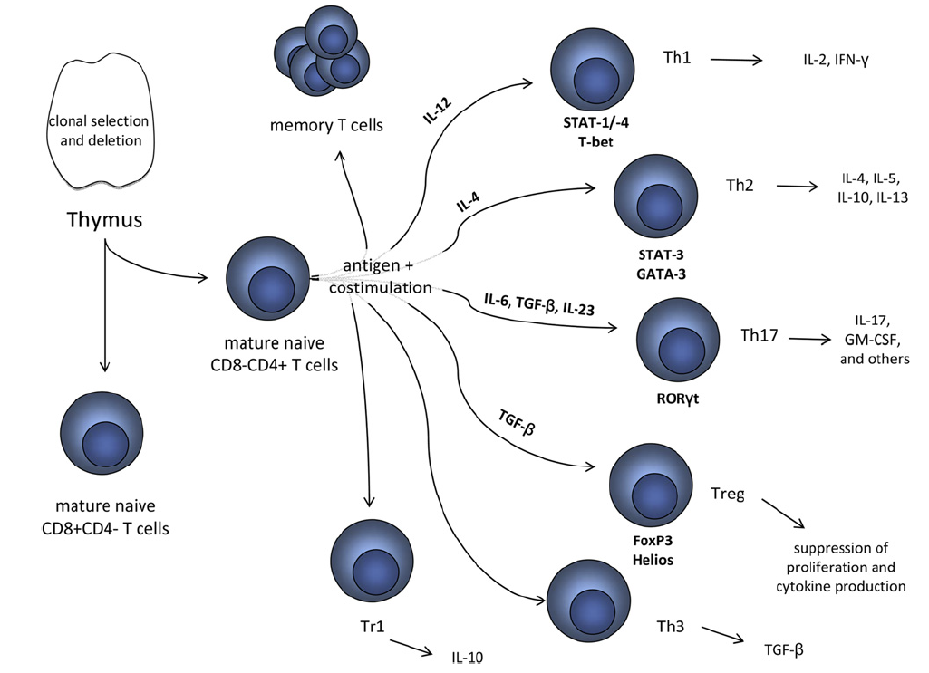
Adaptive immunity & Rheumatic diseases
A.R.Rajaei MD
Notes:
Developmental pathway of CD4þ T cells and their effectors. Immature T cells undergo a stringent process of clonal selection and deletion (positive and negative selection) in the thymus. Naïve T cells exiting the thymus express either surface markers CD8 or CD4 and circulate through blood and lymphoid organs. Upon antigen-specific activation, CD4þ T cells undergo lineage commitment largely depending on the cytokine environment in which they are activated. Differentiation in the presence of IL-12, for example, induces expression of the transcription factor T-bet, which commits cells to the Th1 lineage characterized by the production of IL-2 and IFN-g. A small percentage of activated T cells develop into memory cells. T cell activation leads to a rapid expansion of activated clones, of which around 90% die in a contraction phase that lasts one to two weeks.

Slide 18
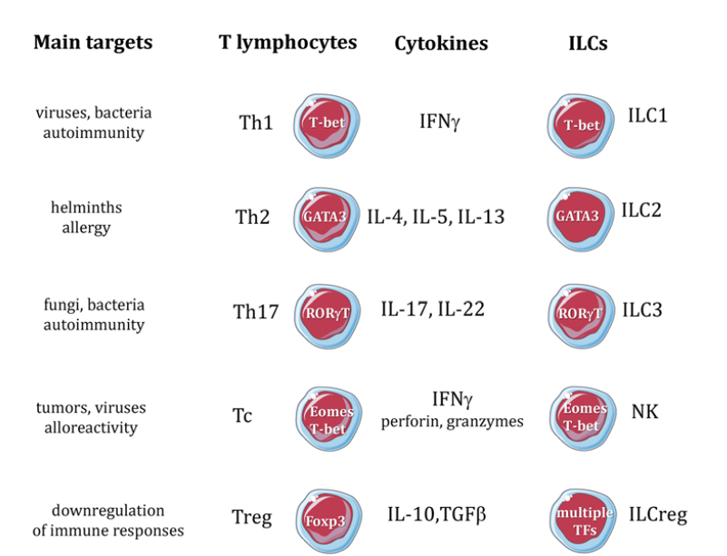
Adaptive immunity & Rheumatic diseases
A.R.Rajaei MD
Notes:
T lymphocytes and innate immune cells share quite similar transcription factors, cytokine profiles, and also effector functions in defense mechanisms and immunopathology

Slide 19
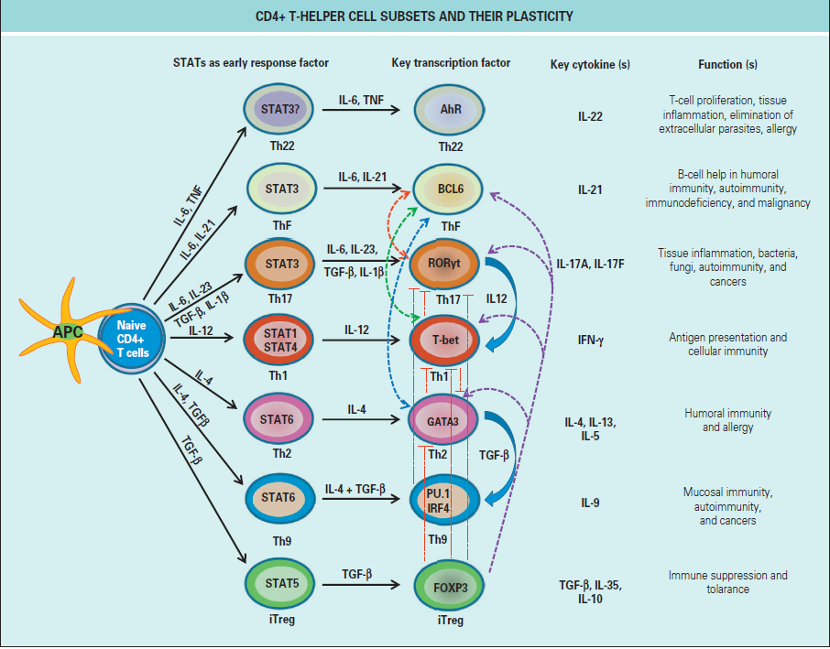
Adaptive immunity & Rheumatic diseases
A.R.Rajaei MD
Notes:
CD4+ T-helper cell subsets and their plasticity. Depending on the nature of antigen stimulation signal received from antigen-presenting cells (APCs),
naive CD4+ T cells differentiate into distinct effector T-helper and regulatory T-cell subsets, which are characterized by expression of lineage-specific transcriptional regulators, cell surface markers, and secretion of key cytokines. Because of plasticity, differentiated effector CD4+ T cells can convert from one cell type into another. Uncontrolled regulation of lineage specification and commitment can result in development of inflammatory, allergic, and autoimmune diseases. IFN, Interferon; IL, interleukin; TGF, transforming growth factor. (Reproduced from Tripathi SK, Lahesmaa R. Transcriptional and epigenetic regulation of T-helper lineage specification.

Slide 20
Adaptive immunity & Rheumatic diseases
A.R.Rajaei MD

Slide 21
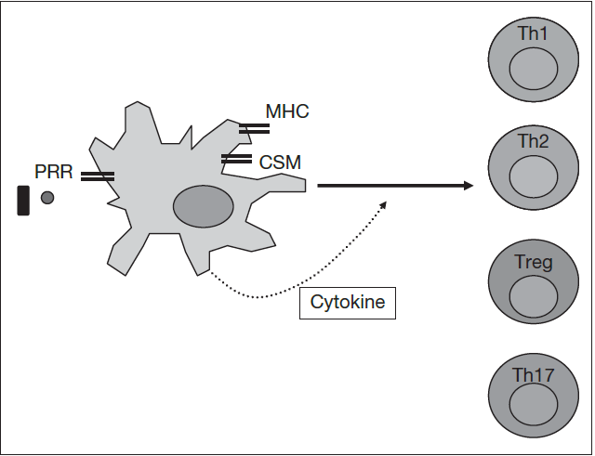
Adaptive immunity & Rheumatic diseases
A.R.Rajaei MD
Notes:
The development of a particular effector (Th1, Th2, Th17) or regulatory T-cell population after interaction between major histocompatibility complex (MHC)/antigen on dendritic cells and the TCR depends on co-stimulatory molecule (CSM) expression and cytokine profile produced. Various stimuli, such as bacteria interacting with pattern recognition receptors (PRR) on DCs determine CSM and cytokine expression and therefore T-cell differentiation.

Slide 22
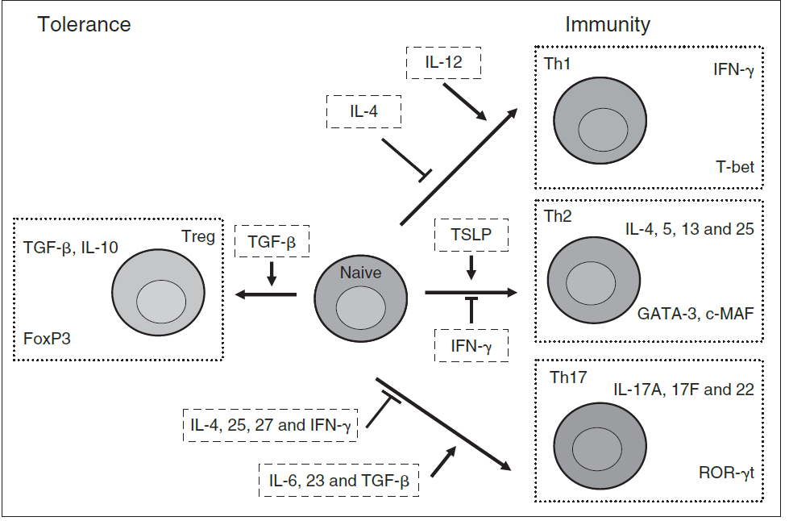
Adaptive immunity & Rheumatic diseases
A.R.Rajaei MD
Notes:
The differentiation of naïve T cells to various effector/regulatory populations depends on the negative and positive effects of various cytokines. The distinct
phenotypic features of each populations reflect the cytokines they produce (top corner of each box) and the transcription factors they express (bottom corner).

Slide 23
Adaptive immunity & Rheumatic diseases
A.R.Rajaei MD

Slide 24
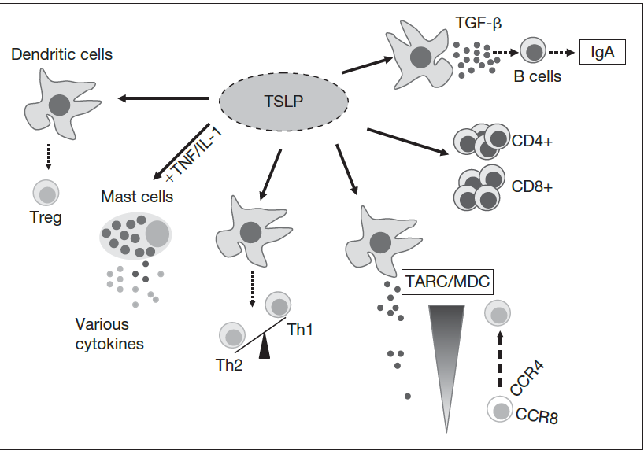
Adaptive immunity & Rheumatic diseases
A.R.Rajaei MD
Notes:
Thymic stromal lymphopoietin (TSLP) is emerging as a cytokine of interest. The biological effects ascribed to TSLP so far are summarized here.

Slide 25
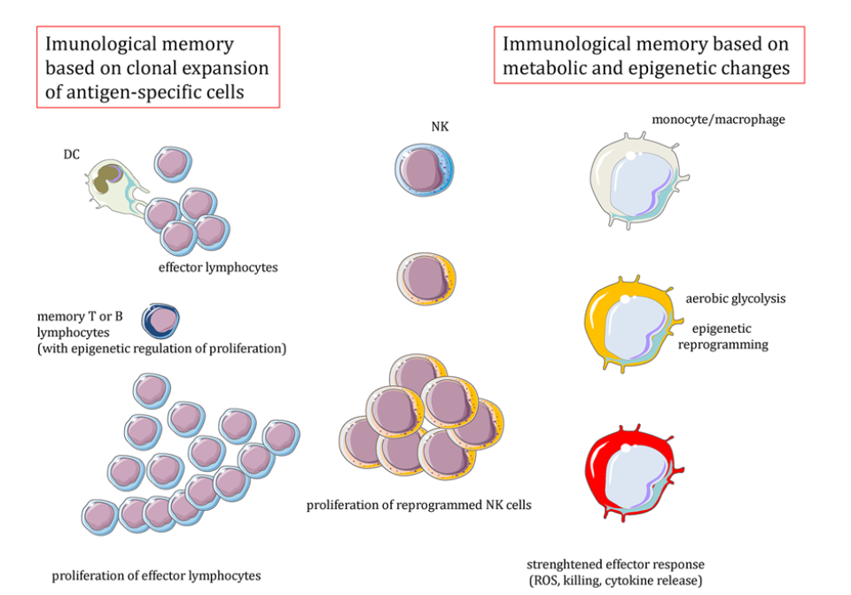
Adaptive immunity & Rheumatic diseases
A.R.Rajaei MD
Notes:
Immunological memory is not an exclusive property of adaptive immune responses In addition to proliferation of antigen-specific T and B lymphocytes generated from memory cells, the capacity to respond faster and more efficiently to an antigen re-exposure may be also associated with metabolic and epigenetic reprogramming of monocytes and other innate immune cells. In NK cells, proliferation of reprogrammed cells is involved.

Slide 26
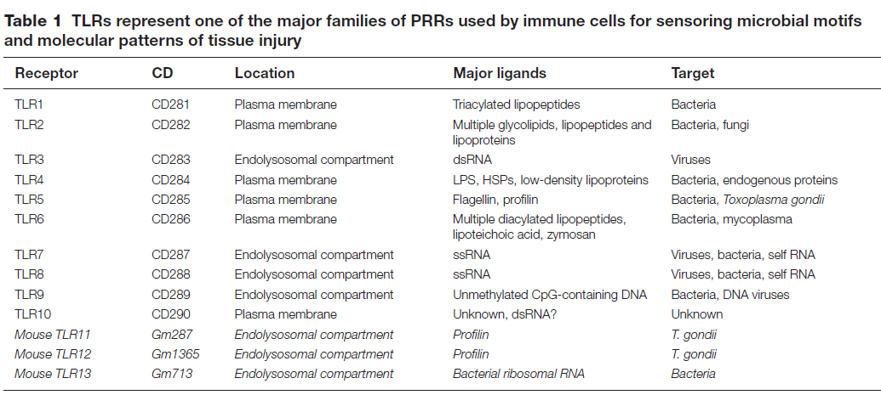
Adaptive immunity & Rheumatic diseases
A.R.Rajaei MD

Slide 27
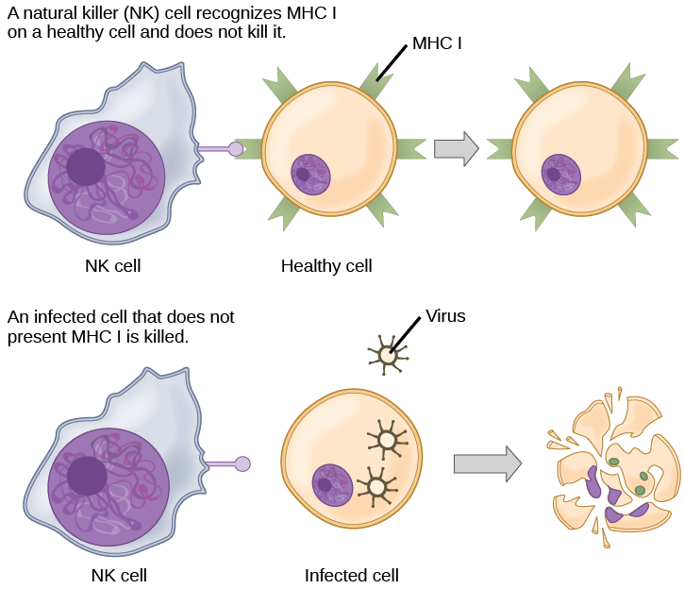
Natural killer (NK) cells recognize the MHC I receptor on healthy cells. If MHC I is absent, the cell is lysed.
Adaptive immunity & Rheumatic diseases
A.R.Rajaei MD

Slide 28
Exercises
1- Which of the following statements about T cells is false?
A-Helper T cells release cytokines while cytotoxic T cells kill the infected cell.
Helper
B-T cells are CD4+, while cytotoxic T cells are CD8+.
C-MHC II is a receptor found on most body cells, while MHC I is a receptor found on immune cells only.
D- The T cell receptor is found on both CD4+ and CD8+ T cells.
2- Based on what you know about MHC receptors, why do you think an organ transplanted from an incompatible donor to a recipient will be rejected?
3- The Rh antigen is found on Rh-positive red blood cells. An Rh-negative female can usually carry an Rh-positive fetus to term without difficulty. However, if she has a second Rh-positive fetus, her body may launch an immune attack that causes hemolytic disease of the newborn. Why do you think hemolytic disease is only a problem during the second or subsequent pregnancies?
Adaptive immunity & Rheumatic diseases
A.R.Rajaei MD

Slide 29
4- Which of the following is both a phagocyte and an antigen-presenting cell?
A- NK cell
B-eosinophil
C-neutrophil
D-macrophage
5- Which immune cells bind MHC molecules on APCs via CD8 coreceptors on their cell surfaces?
A-TH cells
B-CTLs
C-mast cells
D-basophils
6-What “self” pattern is identified by NK cells?
A-altered self
B-missing self
C-normal self
D-non-self
Adaptive immunity & Rheumatic diseases
A.R.Rajaei MD

Slide 30
7-The acquired ability to prevent an unnecessary or destructive immune reaction to a harmless foreign particle, such as a food protein, is called ________.
A-the TH2 response
B-allergy
C-immune tolerance
D-autoimmunity
8-A memory B cell can differentiate upon re-exposure to a pathogen of which cell type?
A-CTL
B-naïve B cell
C-memory T cell
D-plasma cell
9-Foreign particles circulating in the blood are filtered by the ________.
A-spleen
B-lymph nodes
C-MALT
D-lymph
Adaptive immunity & Rheumatic diseases
A.R.Rajaei MD

Slide 31
10-Explain the difference between an epitope and an antigen.
11-What is a naïve B or T cell?
12-How does the TH1 response differ from the TH2 response?
13-In mammalian adaptive immune systems, T cell receptors are extraordinarily diverse. What function of the immune system results from this diversity, and how is this diversity achieved?
14-How do B and T cells differ with respect to antigens that they bind?
15- Why is the immune response after reinfection much faster than the adaptive immune response after the initial infection?
Adaptive immunity & Rheumatic diseases
A.R.Rajaei MD

Slide 32
1- C
2- MHC receptors differ from person to person. Thus, MHC receptors on an incompatible donor are considered “non-self” and are rejected by the immune system.
3- If the blood of the mother and fetus mixes, memory cells that recognize the Rh antigen can form late in the first pregnancy. During subsequent pregnancies, these memory cells launch an immune attack on the fetal blood cells. Injection of anti-Rh antibody during the first pregnancy prevents the immune response from occurring.
4- D
5- B
6- B
7- C
8- D
9- A
Adaptive immunity & Rheumatic diseases
A.R.Rajaei MD

Slide 33
10- An antigen is a molecule that reacts with some component of the immune response (antibody, B cell receptor, T cell receptor). An epitope is the region on the antigen through which binding with the immune component actually occurs.
11- A naïve T or B cell is one that has not been activated by binding to the appropriate epitope. Naïve T and B cells cannot produce responses.
12- The TH1 response involves the secretion of cytokines to stimulate macrophages and CTLs and improve their destruction of intracellular pathogens and tumor cells. It is associated with inflammation. The TH2 response is involved in the stimulation of B cells into plasma cells that synthesize and secrete antibodies.
13- The diversity of TCRs allows the immune system to have millions of different T cells, and thereby to be specific in distinguishing antigens. This diversity arises from mutation and recombination in the genes that encode the variable regions of TCRs.
14- T cells bind antigens that have been digested and embedded in MHC molecules by APCs. In contrast, B cells function themselves as APCs to bind intact, unprocessed antigens.
15- Upon reinfection, the memory cells will immediately differentiate into plasma cells and CTLs without input from APCs or TH cells. In contrast, the adaptive immune response to the initial infection requires time for naïve B and T cells with the appropriate antigen specificities to be identified and activated.
Adaptive immunity & Rheumatic diseases
A.R.Rajaei MD

Slide 34
Practice points
The most important characteristics of the adaptive immune system are specificity for antigen, the ability to modulate and enhance this specificity and the ability to generate life-long memory.
Both central and peripheral control mechanisms are crucial to prevent reactivity to self.
Rheumatic diseases comprise a wide spectrum of conditions, of which some are caused by the adaptive immune system, while others develop because of defects of the innate immune system.
The potential of the adaptive immune system to induce autoimmunity is usually controlled by a combination of deletional and regulatory tolerance mechanisms. Regulatory T cells play a central role in maintaining immune tolerance.
Failure of tolerance leads to autoimmunity, in which the immune system attacks its own tissues. Autoimmunity commonly occurs in and contributes to mechanisms of rheumatic diseases. By its nature, the adaptive immune system potentially represents the most specific target for therapy in autoimmune diseases.
Adaptive immunity & Rheumatic diseases
A.R.Rajaei MD

